Slide 1
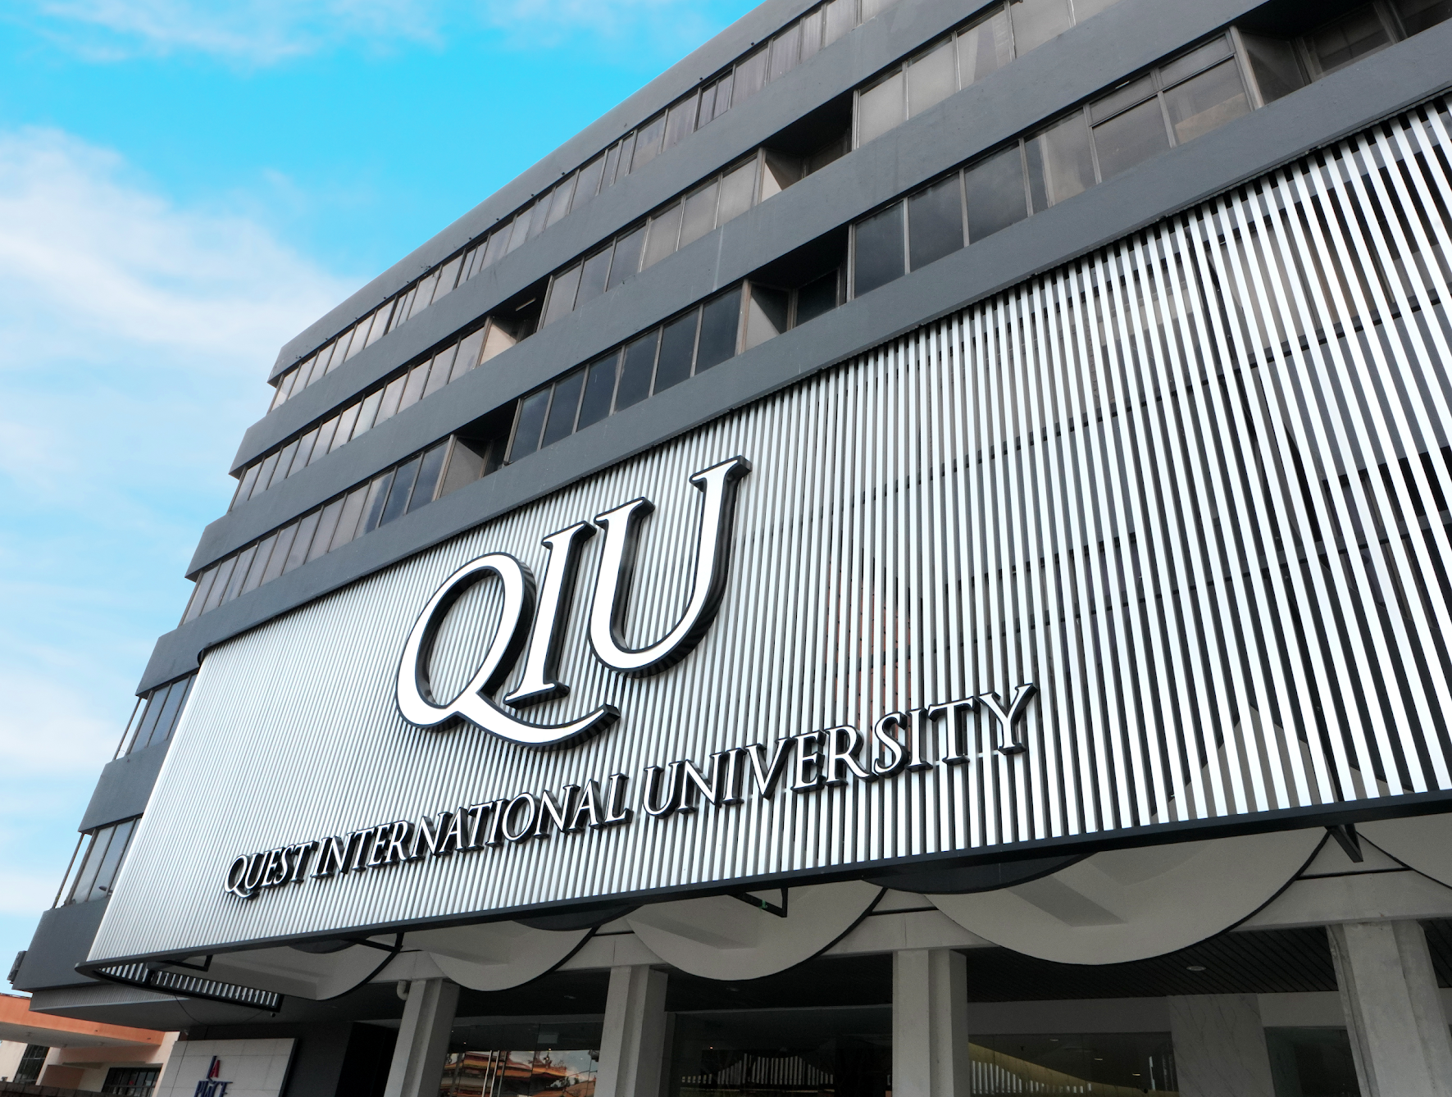

Clubs & Societies Briefing
by: SLD,
Ms Chong Yee Shiun

Slide 2

Meeting Agenda
01
Club Active Status Maintenance Requirements
06
Event Documentation
02
Permanent Venue Booking Arrangement
07
AGM
03
Event Proposal Submission & Details
08
Weekly Activity CCA Point Claim Guidelines
04
Poster Design and Publicity Requirements
09
Club T-Shirt Printing
05
Event Reels Submission Requirement
10
Club Fund Withdrawal Procedure

Slide 3


Club Active Status Maintenance Requirements
Conduct regular activities
Organize meetings, activities, or events regularly.
Do not remain inactive for more than 3 consecutive months.
Organize at least one event per year.
Submit required documents and records on time to the SLD.
Conduct AGM and maintain club leadership
Stay responsive to Student Life Division
Reply to official communication, requests, or instructions within 7 working days.

Slide 4

AGM
Service Term: July 2026 – June 2027.
AGM Deadline: 30 September 2026.
Report Submission Deadline: 9 October 2026.
Committee Commitment: Newly elected committee members must be able to serve the full term (July 2026 – June 2027).
Documents to Submit:
  AGM Report
  Financial Report
  Full Members List
  Annual Activities Report

Slide 5
Permanent Venue Booking Arrangement
Google Form will be provided for semesterly permanent venue booking.
All clubs (including sports clubs for court bookings) are required to submit the request form every semester.
Venue allocation will be based on number of participants (pax) and availability.
Requests for a bigger room for one-off events must be submitted at least 1 week before the event via email to Ms YS.
Failure to secure a permanent booking will require weekly venue booking and may result in no venue availability.
Reminder: Do not park vehicles outside the basketball court area as it will block the bus.

Slide 6
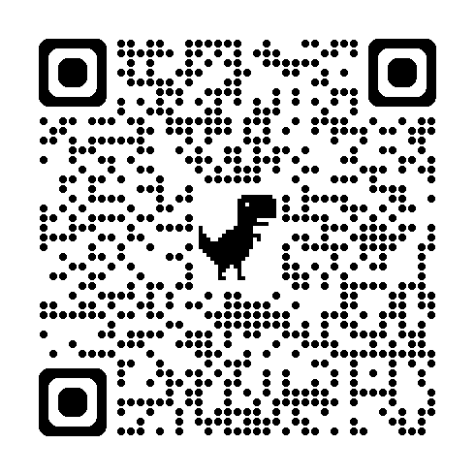

Slide 7
Event Proposal
Discuss your event idea in details with your advisor / Ms YS before submitting the proposal.
Submission Deadlines:
  Small event (<60 participants) - 1.5 months before the event
  Big event (>60 participants) - 3 months before the event
Events that need to submit Proposal | Event that doesn’t need to submit Proposal
Involve non-club members Open to QIU students/staff Involve third party (eg: invite speaker from outside) | Weekly activity Small event that involves within club members Advisor must be there if meeting outside Must submit Indemnity Form

Slide 8
Event Proposal
Use the “Event Proposal Template”.
Email the Proposal to Ms YS, Ms Azlina, CC Ms Kasthury and Mr Desmond
Ms YS will acknowledge receipt and review the proposal.
Proposal will be submitted to the management for approval. It shall take about 2 weeks.
Prepare the artwork (poster, design) while preparing the proposal.
Advisor’s signature is required. .
Dean’s signature is required for faculty related event.
All the signatures must be obtained before submitting the proposal to SLD for approval.

Slide 9
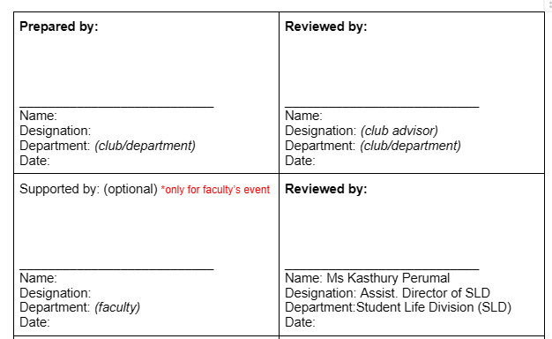
Event Proposal

Slide 10
Content of the
Event Proposal
Target Participants
  Expected number of participants:
  Eligibility:
ICT & Maintenance Requirement
Logistic Arrangements
  Transportation required / not required. By participants own transportation / university transportation etc
  Departure Time:
  Pickup Point:
  Estimated Return Time:
  Pickup Point:

Slide 11

Event Reels Submission Requirement
All clubs are required to produce one event reel for every event organized.
Upload the reel to the designated Google Drive.
Reels will be featured on the La Place LED Screen.

Slide 12

Indemnity Form
This form must be completed for ALL off-campus events
Students must submit the form before the event.
The completed form must be emailed at least 3 days before the event.
Upload all the documents in the Google Drive, then email to inform
  Ms YS – yeeshiun.chong@qiu.edu.my
  CC Ms Azlina – norazlina.ismail@qiu.edu.my
Ms YS will acknowledge receipt of the email

Slide 13

La Place Booking
Complete the Google Booking Form (Refer to the SOP shared)
After submission, send an email to Ms YS
Email must include:
  Purpose of the booking
  Items to be sold or promoted
  Brief description of activities
SLD will liaise with La Place’s PIC to verify availability.
Once confirmed, SLD will respond via email.

Slide 14
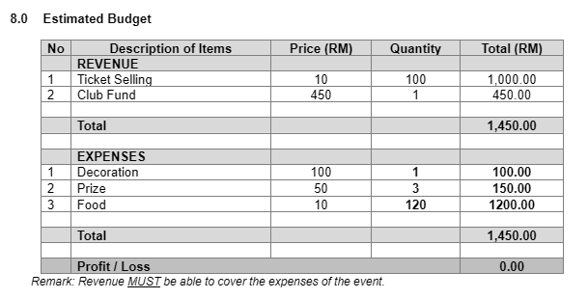
Event Budget Planning and Financial Guidelines

Slide 15
Poster Design and Publicity Requirements
Poster Checklist:
Student Activity logo and Club/Project logo(s).
Organizer identified above the event title or at the bottom.
Event title
Tagline/purpose of the event
Date and day
Timing (from–to)
Venue/Platform
Registration method (if applicable)
CCA points (if applicable)
Contact details (name and phone number)
Remark: No human or AI-generated human images. Only actual QIU event photos are allowed.

Slide 16

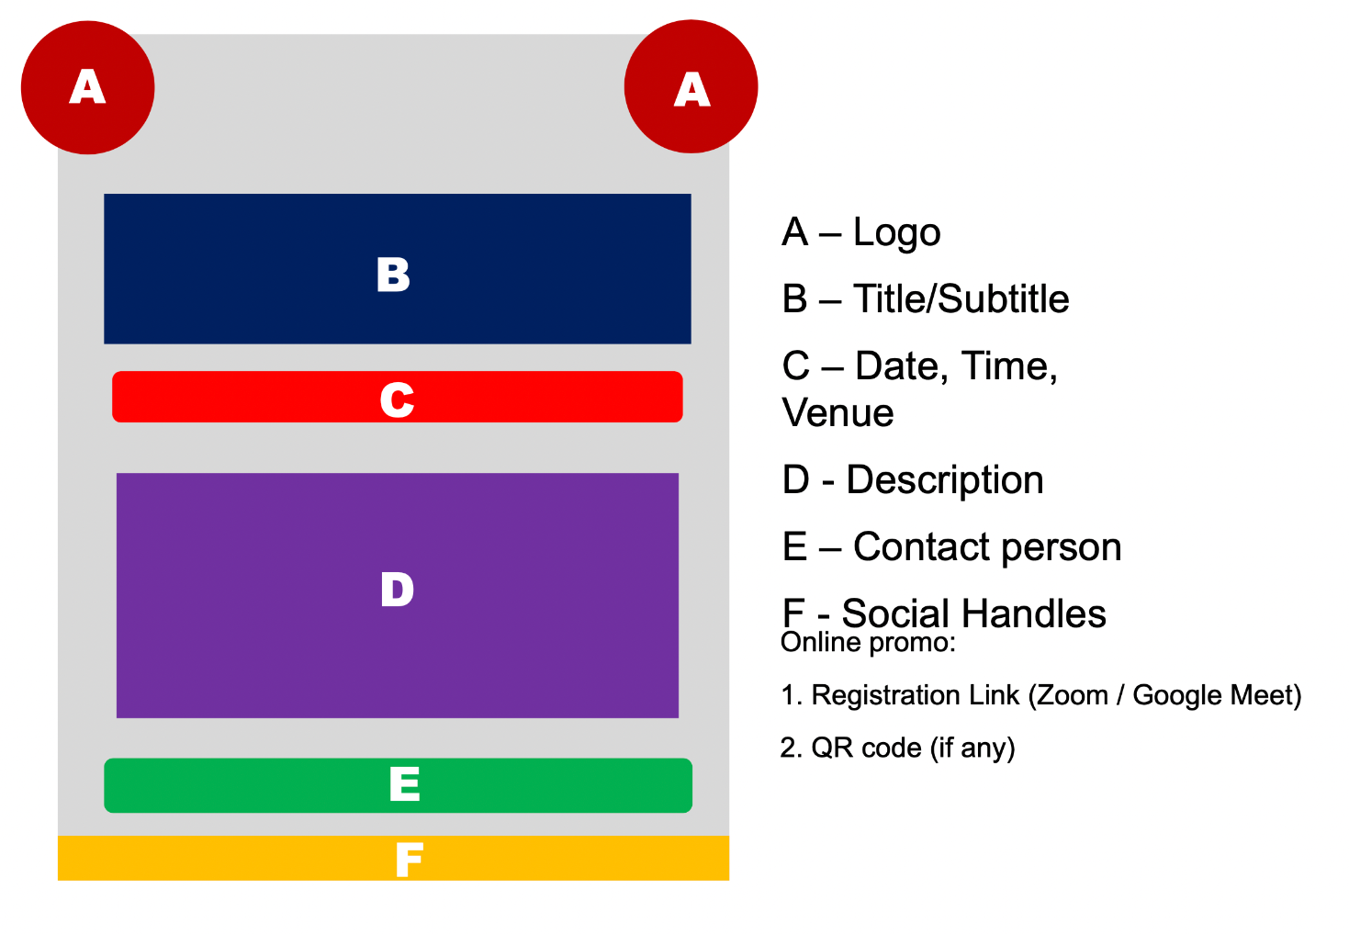

Poster Design and Publicity Requirements

Slide 17
Event Documentation
Upon proposal approval, a Google Drive folder will be shared together with the approved proposal.
Clock-In/Clock-Out QR will be uploaded before the event. A separate Payment QR will be provided for ticketed events.
The folder consists of:
  Event Documents
  Event Photos
  Invoices & Receipts

Slide 18
Event Documentation
4. Upload the following documents:
  Approved Event Proposal
  Event Poster
  Participants List
  Post Mortem Report
  Post-Event Survey
5. Upload all original purchase receipts. Bank transaction records are not accepted.
6. Prepare a Financial Record and submit all documents within 1 week after the event.
7. All documents should be uploaded within 2 weeks after the event.

Slide 19
Weekly Activity CCA Point Claim Guidelines
Submit weekly attendance using the provided template.
Submit 2 documents:
  Excel Attendance List
  Minutes of Meeting Report (Word)
Minutes of Meeting should summarize the discussion and activities conducted.
Activities may be online or offline, but must align with the club's objectives. (E.g. Indoor Club: Plato activities are not accepted.)
Both documents are required for CCA points to be awarded.

Slide 20
Club Fund Withdrawal Procedure
Complete the Fund Withdrawal Form and obtain the Advisor's signature.
Submit fund withdrawal requests at least 2 weeks in advance for weekly activities.
For events, submit the fund withdrawal request immediately after the event proposal is approved.
The Treasurer is responsible for maintaining an up-to-date financial record.
Keep and submit all original purchase receipts for financial verification.

Slide 21

T-shirt printing
Submit a proposal before production. .
T-shirt design must be approved by Digital Communications Team.
QIU Logo must be at the left while Club logo at the right.
Require 1 external quotation and 1 internal quotation.
Quotation shall include the following details:
  Unit price (by size or standard 1 price for all size)
  Cloth materials: cotton/microfibre
  Printing: One-sided / Two-sided
  Colors: B&W / 2 colors / multi-colors
  Printing method: Silkscreen / DTF / Embroidery
  Collar style: Round-neck / V-neck

Slide 22

List of Templates & Forms
AGM Report Template
Finance Report
Event Attendance List Template (excel)
External Event CCA Request Form
SLD Indemnity Form
Event Proposal Template
Student Organization Fund Withdrawal and Transfer Form
SOP to book La Place
Event Post Mortem Template
Full Member List
Post Event Survey
Meeting Minutes Template

Slide 23

Things to Do
Items | Deadline
AGM Completion | 31 Dec 2025 (Wed)
2. AGM Report Submission | 9 Jan 2026 (Fri)
3. Fill up Google Form for number of member pax to use the room - use for permanent booking | 19 Dec 2025 (Fri), 1pm
4. 1 semester event calendar | 9 Jan 2026 (Fri)
5. Full members list | 22 Dec 2025 (Mon)

Slide 24

THANK YOU

